Slide 1
SAMPLE SIZE CALCULATION

Slide 2
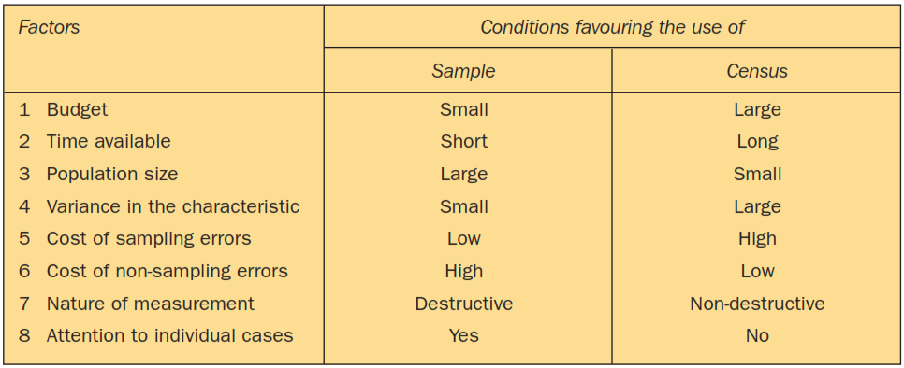
SAMPLE VERSUS CENSUS

Slide 3
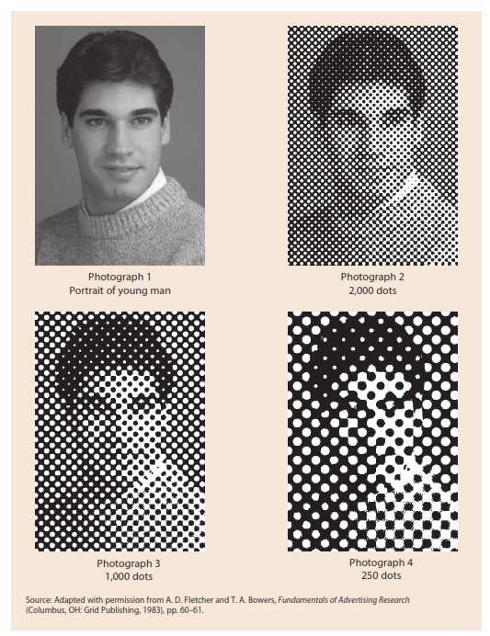
Rs 500
Rs 100
Rs30
Rs 50

Slide 4
Minimum required sample size in estimating the population mean

Slide 5
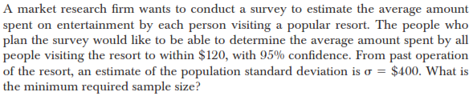

Slide 6
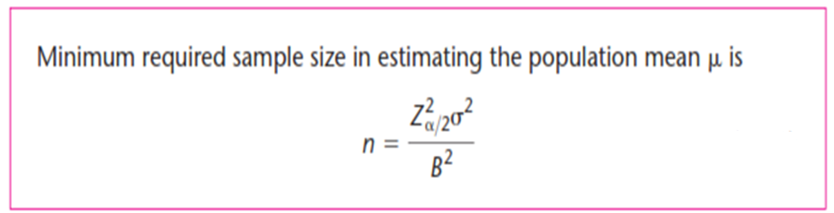
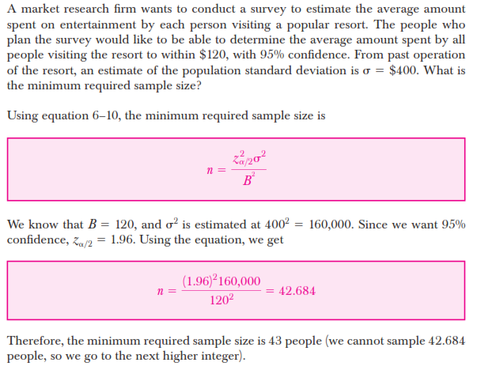

Slide 7
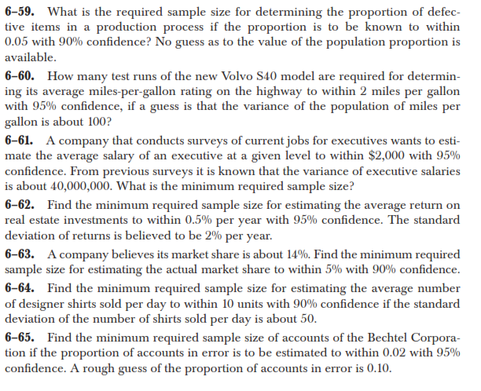
Answer – 96.04 ~ 97

Slide 8
Answer – 38.416 ~ 39

Slide 9
Answer – 67.65 ~ 68

Slide 10
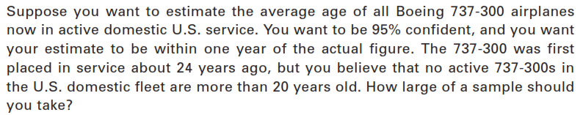
The range rule of thumb says that the range is approximately four times the standard deviation. Alternatively, the standard deviation is approximately one- fourth the range. That means that most of he data lies within two standard deviation of the mean.
Answer – 96.04 ~ 97

Slide 11
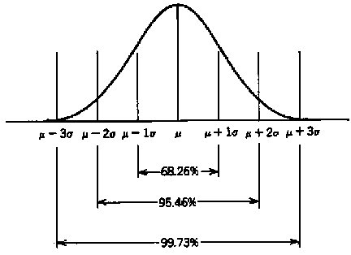

Slide 12
The lengths of metal rods produced by an industrial process are normally distributed with a standard deviation of 1.8 millimeters. Based on a random sample of nine observations from this population, the 99% confidence interval was found for the population mean length to extend from 194.65 to 197.75. Suppose that a production manager believes that the interval is too wide for practical use and, instead, requires a 99% confidence interval extending no further than 0.50 mm on each side of the sample mean. How large a sample is needed to achieve such an interval?
Answer - 85.93~ 86

Slide 13
A previous study that investigated the cost of renting automobiles in the United States found a mean cost of approximately $55 per day for renting a midsize automobile. Suppose that the organization that conducted this study would like to conduct a new study in order to estimate the population mean daily rental cost for a midsize automobile in the United States. In designing the new study, the project director specifies that the population mean daily rental cost be estimated with a margin of error of $2 and a 95% level of confidence. An analyst reviewed the sample data from the previous study and found that the sample standard deviation for the daily rental cost was $9.65.
Answer – 89.43~ 90

Slide 14
The average cost of a gallon of unleaded gasoline in Greater Cincinnati was reported to be $2.41 (The Cincinnati Enquirer, February 3, 2006). During periods of rapidly changing prices, the newspaper samples service stations and prepares reports on gasoline prices frequently.
Assume the standard deviation is $.15 for the price of a gallon of unleaded regular gasoline, and recommend the appropriate sample size for the newspaper to use if they wish to report a margin of error at 95% confidence.
Suppose the desired margin of error is $.07.
Suppose the desired margin of error is $.05.
Suppose the desired margin of error is $.03.
Answer
17.64 ~ 18
34.57 ~ 35
96.04 ~ 97

Slide 15
An online survey by ShareBuilder, a retirement plan provider, and Harris Interactive reported that 60% of female business owners are not confident they are saving enough for retirement (SmallBiz, Winter 2006). Suppose we would like to do a follow-up study to determine how much female business owners are saving each year toward retirement and want to use $100 as the desired margin of error for an interval estimate of the population mean. Use $1100 as a planning value for the standard deviation and recommend a sample size for each of the following situations.
A 90% confidence interval is desired for the mean amount saved.
A 95% confidence interval is desired for the mean amount saved.
A 99% confidence interval is desired for the mean amount saved.
Answer
327.42 ~ 328
464.83 ~ 465
802.30 ~ 303

Slide 16
During the first quarter of 2003, the price/earnings (P/E) ratio for stocks listed on the New York Stock Exchange generally ranged from 5 to 60 (The Wall Street Journal, March 7, 2003). Assume that we want to estimate the population mean P/E ratio for all stocks listed on the exchange. How many stocks should be included in the sample if we want a margin of error of 3? Use 95% confidence.
Answer – 80.7 ~ 81

Slide 17
An economist is interested in estimating the average monthly household expenditure on food items by the households of a town. Based on the past data , it is estimated that the standard deviation of the population on the monthly expenditure on food item id Rs 30/-. With allowable error set at Rs 7/-, estimate the sample size required at a 90 percent confidence.
Answer – 49.40 ~ 50

Slide 18
You are given a population with a standard deviation of 8.6. Determine the sample size needed to estimate the mean of the population within +/- 0.5 with 90% confidence.
Answer – 1961.60 ~ 1962

Slide 19
It is desired to estimate he mean life time of a certain kind of vacuum cleaner. Given that the population standard deviation is 320 days. how large a sample size is needed to be able to assert with confidence level of 96 percent that the sample will differ from the population mean by less than 45 days. (Z value for 96 % is 2.055)
Answer – 213.55 ~ 214

Slide 20
The axial length of piston produced follows a normal distribution with the variance of 64mm. Determine the sample size such that the mean length is within plus or minus 2mm with a confidence level of 95%
Answer – 61.46 ~ 62

Slide 21
Brian Gray 292:
A state politician would like to determine the average amount earned during summer employment by state teenagers during the past summer’s vacation period. She wants to have 95% conﬁdence that the sample mean is within $50 of the actual population mean. Based on past studies, she has estimated the population standard deviation to be $400. Answer 245.9 ~ 246
Answer – 245.9 ~ 246

Slide 22
Douglas 2017 pg 305
A student in public administration wants to estimate the mean monthly earnings of city council members in large cities. She can tolerate a margin of error of $100 in estimating the mean. She would also prefer to report the interval estimate with a 95% level of confidence. The student found a report by the Department of Labor that reported a standard deviation of $1,000. What is the required sample size?
384.16 ~ 385

Slide 23
Minimum required sample size in estimating the population proportion

Slide 24


Slide 25
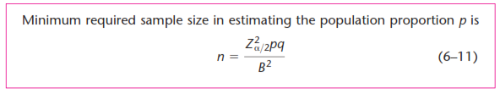
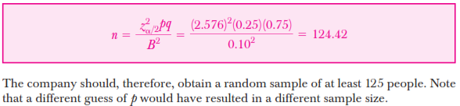

Slide 26
Answer – 270.64 ~ 271

Slide 27
Answer – 130.32 ~ 131

Slide 28
Answer – 864.36 ~ 865

Slide 29
Suppose that an opinion survey following a presidential election reported the views of a sample of U.S. citizens of voting age concerning changing the Electoral College process. The poll was said to have a 3% margin of error. The implication is that a 95% confidence interval for the population proportion holding a particular opinion is the sample proportion plus or minus at most 3%. How many citizens of voting age need to be sampled to obtain this 3% margin of error?
Answer – 1067.11 ~ 1068

Slide 30
At 95% confidence, how large a sample should be taken to obtain a margin of error of .03 for the estimation of a population proportion? Assume that past data are not available for developing a planning value for p.
Answer – 1067.11 ~ 1068

Slide 31
The percentage of people not covered by health care insurance in 2003 was 15.6% (Statistical Abstract of the United States, 2006). A congressional committee has been charged with conducting a sample survey to obtain more current information.
What sample size would you recommend if the committee’s goal is to estimate the current proportion of individuals without health care insurance with a margin of error of .03? Use a 95% confidence level.
Repeat part (a) using a 99% confidence level.
Answer
562
970

Slide 32
41% of Jacksonville resident said that they have been in Hurricane. How many adults should be surveyed to estimate the true proportion of adults who have been in Hurricane. With a 95% confidence interval 6 % wide.
Answer – 1032.56 ~ 1033

Slide 33
A manager of a department store would like to study women’s spending per year on cosmetics. He is interested in knowing the population proportion of women who purchase their cosmetics primarily from his store. If he wants to have a 90 % confidence of estimating the true proportion to be within +/- 0.045, what sample size is needed
Answer – 334.07 ~ 335

Slide 34
A consumer electronics company wants to determine the job satisfaction level of its employees. For this ask simple question. ‘Are you satisfied with your job?’ it was estimated that no more than 30 % of the employees would answer yes. What would be the sample size for this company to estimate the population proportion to ensure a 95% confidence in the result. And to be within 0.04 of the true population proportion.
Answer – 504.21 ~ 505

Slide 35
A market researcher for a consumer electronics company would like to study the television viewing habits of the residents of a particular, small city. What sample size is needed if he wishes to be 95% confident of being within +/- 0.035 of the true proportion who watch the evening news on at least 3 weeknights if no previous estimate is available.
Answer – 784

Slide 36
The manager of a a bank feels that 35% of branches will have enhanced yearly collection of deposits after introducing a hike in interest rate. Determine the sample size to estimate the population proportion such that the proportion is within plus or minus 0.06 at a confidence level of 90%
Answer – 170

Slide 37
Sample size population mean, Brian Gray 295:
A tourist agency researcher would like to determine the proportion of U.S. adults who have ever vacationed in Mexico and wishes to be 95% conﬁdent that the sampling error will be no more than 0.03 (3 percentage points).
Answer 1067.1 ~ 1068

Slide 38
THANK YOU

Slide 39
Incidence rate refers to the rate of occurrence or the percentage of persons eligible to participate in the study. Incidence rate determines how many contacts need to be screened for a given sample size requirement.
For example, suppose that a study of pet ownership targets a sample of households. Of the households that might be approached to see if they qualify, approximately 75% own a pet. This means that, on average, 1.33 households would be approached to obtain one qualified respondent.
Additional criteria for qualifying respondents (e.g. product usage behaviour) will further increase the number of contacts. Suppose that an added eligibility requirement is that the household should have bought a toy for their pet during the last two months. It is estimated that 60% of the households contacted would meet this criterion. Then the incidence rate is 0.75 X 0.6 = 0.45. Thus the final sample size will have to be increased by a factor of (1/0.45) or 2.22.

Slide 40

Similarly, the determination of sample size must take into account anticipated refusals by people who qualify. The completion rate denotes the percentage of qualified respondents who complete the interview.
If, for example, the researcher expects an interview completion rate of 80% of eligible respondents, the number of contacts should be increased by a factor of 1.25.
The incidence rate and the completion rate together imply that the number of potential respondents contacted – that is, the initial sample size – should be 2.22 X 1.25 or 2.78 times the sample size required.

Slide 41
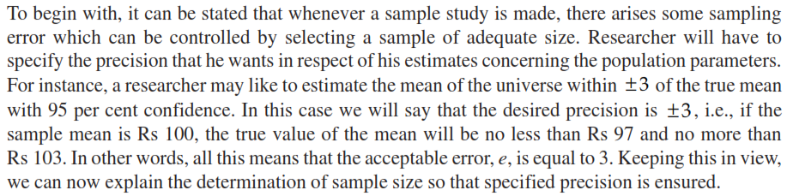

Slide 42

Assume we have 10000 students in our campus. We want to know their age and take some decision. We do not have any internal data on this.
One option is to we ask all students and get their age. This comes to 26.
Second option is to ask few students and ask their age and extrapolate to the population.
I am a statistician and I do a estimation of the students age of our college and say with 95% confidence that the age will be between 22 to 28 years. (This basically means that if we take 100 students 95 students will have age between 22 to 28 years and 5 students will have age not between 22 to 28 years).
To do this estimation we use formula
2
26

Slide 43
If you have traveled 1000 times you are 100% sure (means 100% confident that the travel time is 40 minutes
If you have traveled 500 times you are 95% sure (means 95% confident that the travel time will be between 35 to 45minutes ( this is a confidence interval with 5 as error and 35 and 45 being the lower and 45 being upper limit).
If you have traveled 50 times you are 90% sure (means 90% confident that the travel time will be between 30 to 50minutes ( this is a confidence interval with 10 as error and 30 and 50 being the lower and 45 being upper limit.

